Slide 1
Introduction to data structures
What is data structures
Classification of data structures: Primitive and non-primitive data structures
Data structure operations
ADT
Algorithim
Presented By
Manish Rai
Assistant Professor, AIML-CSE

Slide 3
Data Structure
Data -Data is a representation of facts or concepts in an organized manner.
Information is defined as a collection of data from which conclusions may be drawn.
The study of how the data is collected and stored in the memory, how efficiently the data is organized in the memory, how efficiently the data can be retrieved and manipulated, and the possible ways in which different data items are logically related is called data structures.

Slide 4

Depending on the organization of the elements, data structures are classified into two types:-
1) LINEAR DATA STRUCTURES
Elements are accessed in a sequential order but it is not compulsory to store all
elements sequentially.
Examples: Linked Lists, Stacks and Queues.
2) NON – LINEAR DATA STRUCTURES
Elements of this data structure are stored/accessed in a non-linear order.
Examples: Trees and graphs.
Notes:
Seq – 3 6 5 2
Non sequce- in a random way we can accessed /stored

Slide 5

❖ It provides an efficient way of storing and organizing data in the computer so that it can be used efficiently.
❖ Data Structures are widely used in almost every aspect of Computer Science i.e. Operating System, Compiler Design, Artificial intelligence, Graphics and many more.
❖ Main part of many computer science algorithms as they enable the programmers to handle the data in an efficient way.
It plays a vital role in enhancing the performance of a software or a program as the main function of the software is to store and retrieve the user's data as fast as possible.
It is the building blocks of any program or the software.
Notes:
1Eg home arrange – for quick and efficient access 2 for organized to access data and retrieve 3 ds-store and organized and alg retrieve data fast eg collection of rope 4 it enhance the performance of the software because main function of software is store and retrieve data 5 alg- planning –ds

Slide 6

As applications are getting complex and amount of data is increasing day by day, there may arise
so many problems.
(1)
Processor Speed
To handle very large amount of data, high speed processing is required, but as the data is growing day by day to the billions of files per entity, processor may fail to deal with that much amount of data.
(2)
Data Search
Consider an inventory size of 106 items in a store, If our application needs to search for a particular item, it needs to traverse 106 items every time, results in slowing down the search process.
(3)
Multiple Requests
If thousands of users are searching the data simultaneously on a web server, then there are the chances that a very large server can be failed during that process.
To solve these problems, data structures are used. Data is organized to form a data structure in such a way that all items are not required to be searched and required data can be searched instantly.
Notes:
Eg exam roll no in a pdf

Slide 7


(1) Efficiency
❖ Efficiency of a program depends upon the choice of data structures.
❖ Example : suppose, we have some data and we need to perform the search for a particular record. In that case, if we organize our data in an array, we will have to search sequentially element by element. Hence, using array maynot be very efficient here.
❖ There are better data structures which can make the search process efficient like ordered array, binary search tree or hash tables.
(2) Reusability
“Data structures are reusable”
❖ MEANING : Once we have implemented a particular data structure, we can use it at any other place.
❖ Implementation of data structures can be compiled into libraries which can be used by different clients.
(3) Abstraction
Data structure is specified by the ADT which provides a level of abstraction.
The client program uses the data structure
through interface only, without getting into the implementation details.

Slide 8














DataStructures
Primitive
Non–Primitive
Linear
Non–Linear
Char
Float
Static
Dynamic
Array

Slide 9


ARRAY
DEFINITION :- An array is a collection of similar type of data items and each data item is called an element of the array.
DATA TYPES :- The data type of the element may be any valid data type like char, int, float or double.
SUBSCRIPT :- The elements of array share the same variable name but each one carries a different index number known as subscript.
TYPES :- The array can be one dimensional, two dimensional or multidimensional.
EXAMPLES :
A[0], A[1], A[2], A[3], ..........A[98], A[99].

Slide 10


LinkedLists
A linear data structure which is used to maintain a list in the memory.
It can be seen as the collection of nodes stored at non-contiguous memory locations.
Each node of the list contains a pointer to its adjacent node.
STACK
❖ A linear list in which insertion and deletions are allowed only at one end, called top.
❖ It is an abstract data type (ADT), can be implemented in most of the programming languages.
❖ It is named as stack because it behaves like a real-world stack.
❖ For example: - piles of plates or deck of cards etc.

Slide 11


Queue is a linear list in which elements can be inserted only at one end called rear and deleted only at the other
end called front.
It is an abstract data structure, similar to stack.
Queue is opened at both end therefore it follows First-In-First-Out (FIFO) methodology for storing the data items.
GRAPH
❖ DEFINITION : The pictorial representation of the set of elements.
❖ EDGES : It is represented by vertices connected by the links known as edges.
❖ A graph is different from tree in the sense that a graph can have cycle while the tree can not have the one.

Slide 12

TREE
❖ Trees are multilevel data structures with a hierarchical relationship among its elements known as nodes.
❖ The bottommost nodes in the hierarchy are called leaf node.
❖ The topmost node is called root node.
❖ Each node contains pointers to point adjacent nodes.
❖ Tree data structure is based on the parent-child relationship among the nodes.
❖ Each node in the tree can have more than one children except the leaf nodes whereas each node can have atmost one parent except the root node.

Slide 13




o
Data Structure Operations
1) Traversing :-
▪Every data structure contains the set of data elements.
▪It means visiting each element
of the data structure in order to perform some specific operation like searching or sorting.
3) Deletion :-
: The process of removing an element from the datastructure is called Deletion.
We can delete an element from the data structure at any random location.
If we try to delete an element from an empty data structure then underflow occurs.
4) Searching :-
The process of finding the location of an element within the data structure.
5) Sorting :-
▪The process of arranging the data structure in a specific order is known as Sorting.
▪There are many algorithms that can be used to perform sorting, for example, insertion sort, selection sort,
2) Insertion:-
DEFINITION : The processof adding the elements to the data structure at any location.
If the size of data structure is n then we can only insert n-1 data elements into it.
6) Merging :-
When two lists List A and List B of size M and N respectively, of similar type of elements,
clubbed or joined to produce the third list, List C of size (M+N), then this process is called

Slide 14
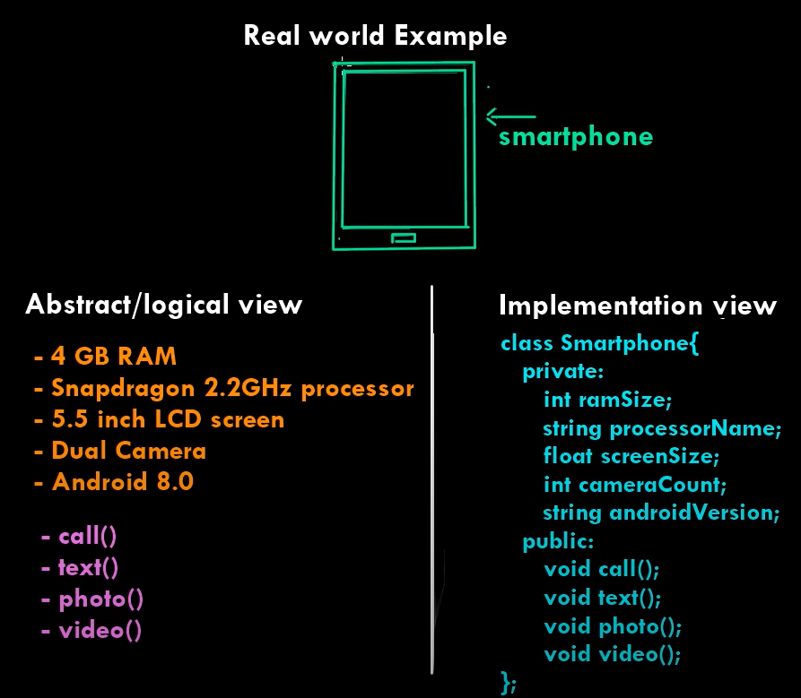
What is ADT ?
Abstract data type refer to a set of data values and associated operations that are specified accuarately ,independent of any particular implementation.
Parts of ADT
Declaration of data
Declaration of operations
Example-stack,queue,linked list etc

Slide 15
Asymptotic Analysis
Time complexity: It is a way of representing the amount of time needed by a program to run to the completion.
Space complexity: It is the amount of memory space required by an algorithm, during a course of its execution. Space complexity is required in situations when limited memory is available and for the multi user system.
It evaluate the performance of the algorithm in terms of its input size.
Using the asymptotic analysis, we can easily conclude about the average case, best case and worst case scenario of an algorithm.
Worst case: It defines the input for which the algorithm takes the huge time.
Average case: It takes average time for the program execution.
Best case: It defines the input for which the algorithm
takes the lowest time.

Slide 16

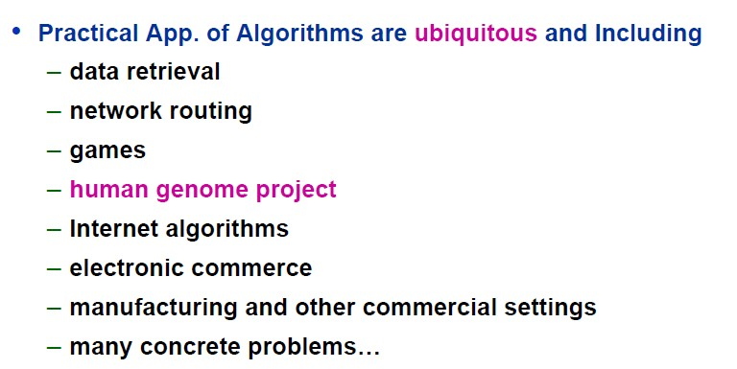
Applications

Slide 17
Example
for(i=0; i<n; i++)
{
statement;
}
Notes:
N+1,n 2n+1 time On

Slide 18
Frequency Count Method
Algorithm Sum(A, n)
{
s = 0;
for(i=0; i<n; i++)
{
s = s + A[i];
}
return s;
}
Notes:
SUM OF ALL THE ELEMENTS IN THE ARRAY time 1,n+1,n,1=2n+3=On time space = A=n,n=5 so 1,s=1,i=1 =n+3 Higher order is On

Slide 19
Frequency Count Method (Example)
Algorithm Add(A,B,n)
{
for(i=0; i<n; i++)
{
for(j=0; j<n; j++)
{
C[i,j] = A[i,j] + B[i,j]
}
}
}
Notes:
Addition of two matrices were A &b are two matrices nis the size of matrc n+1, n*(N+1) ,n =n+1+n^2+n+n*n=n^2+3n+1= O(n^2) time complexity space
Space= A=n^2 B=n^2 C=N^2 I,jn=1 3n^2+3 = 0n^2

Slide 20
Frequency Count Method (Example)
Algorithm Multiply(A, B, n)
{
for(i=0; i<n; i++)
{
for(j=0; j<n; j++)
{
C[i,j] = 0;
for(k=0; k<n; k++)
{
C[i,j] = C[i,j] + A[i,k] * B[i,j];
}
}
}
}

Slide 21
Example
for(i=n; i>0; i--)
{
statement;
}
Notes:
N+1,n On

Slide 22
Example
for(i=1; i<n; i=i+2)
{
statement;
}
Notes:
i=1,3,5,7,9 n/2 O(n) degree of polynomial

Slide 23
Example
for(i=0; i<n; i++)
{
for(j=0; j<n; j++)
{
statement;
}
}
Notes:
n+1, n *(n+1), n*n= 2n^2+2n+1 On^2

Slide 24
Example
p=0;
for(i=1; p<=n; i++)
{
p=p+i;
}
Notes:
i=1, 2, 3, 4
P=0+1, 1+2 1+2+3 1+2+3+4 assume p>n n=n(n+1)/2 k=(k+1)k/2 not p<n not i<n
k*(k+1)/2>n
k^2>n
k=Sqrareroot of n

Slide 25
Example
for(i=1; i<n; i=i*2)
{
statement;
}
Notes:
Log2n How i progresses:
First iteration: i = 1
Second iteration: i = 2
Third iteration: i = 4
...
After k iterations, i = 2^k.
Stopping Condition:
The loop stops when 2^k ≥ n.
This means k = log₂(n).
Time Complexity:
The number of iterations (value of P) is proportional to log₂(n).
Thus, this loop runs in O(log n) time.

Slide 26
Example
for(i=n; i>=1; i=i/2)
{
statement;
}
Notes:
O(Logn) Time Complexity of a loop is considered as O(Logn) if the loop variables is divided / multiplied by a constant amount

Slide 27
Example
for(i=1; i<n; i++)
{
statement;
}
for(j=1; j<m; j++)
{
statement;
}
Notes:
O(m+n)

Slide 28
Example
P=0;
for(i=1; i<n; i=i*2)
{
P++;
}
for(j=1; j<P; j=j*2)
{
statement;
}
Notes:
Log2n first loop second loop log2(log2n)
First Loop: for(i = 1; i < n; i = i * 2)
Iteration Analysis:
The variable i starts at 1 and is multiplied by 2 in each iteration.
This loop continues until i is no longer less than n.
How i progresses:
First iteration: i = 1
Second iteration: i = 2
Third iteration: i = 4
...
After k iterations, i = 2^k.
Stopping Condition:
The loop stops when 2^k ≥ n.
This means k = log₂(n).
Time Complexity:
The number of iterations (value of P) is proportional to log₂(n).
Thus, this loop runs in O(log n) time.
Second Loop: for(j = 1; j < P; j = j * 2)
Iteration Analysis:
The variable j starts at 1 and is multiplied by 2 in each iteration.
This loop continues until j is no longer less than P.
How j progresses:
First iteration: j = 1
Second iteration: j = 2
Third iteration: j = 4
...
After k iterations, j = 2^k.
Stopping Condition:
The loop stops when 2^k ≥ P.
This means k = log₂(P).
Time Complexity:
Since P = log₂(n) from the first loop, the number of iterations in this loop is log₂(P).
Substituting P = log₂(n), we get log₂(log₂(n)).
Therefore, this loop runs in O(log log n) time.

Slide 29
Example
for(i=0; i<n; i++)
{
for(j=1; j<n; j=j*2)
statement;
}
Notes:
N,logn = nlogn

Slide 30
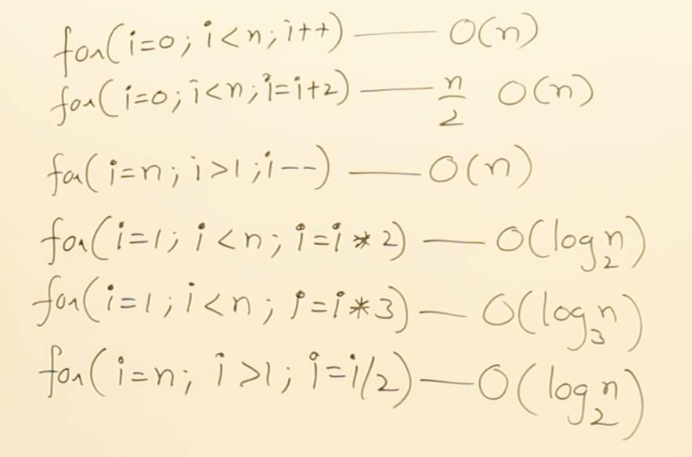
Observations

Slide 31
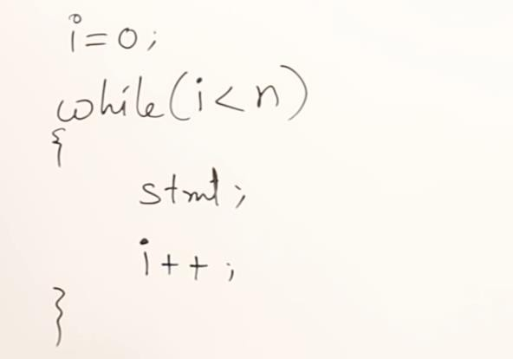
Example of While
Notes:
1,n+1,n,n 3n+2 On

Slide 32
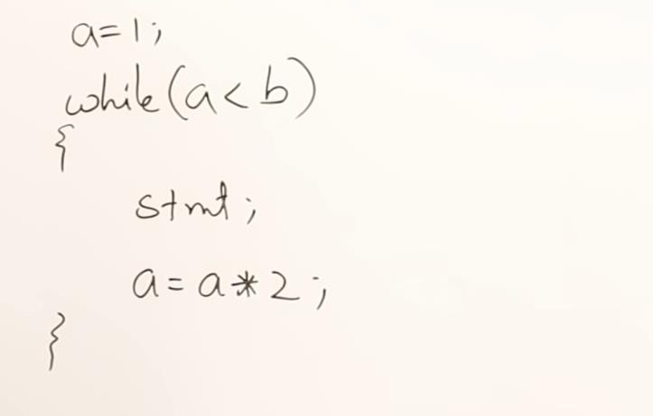
Example of While

Slide 33
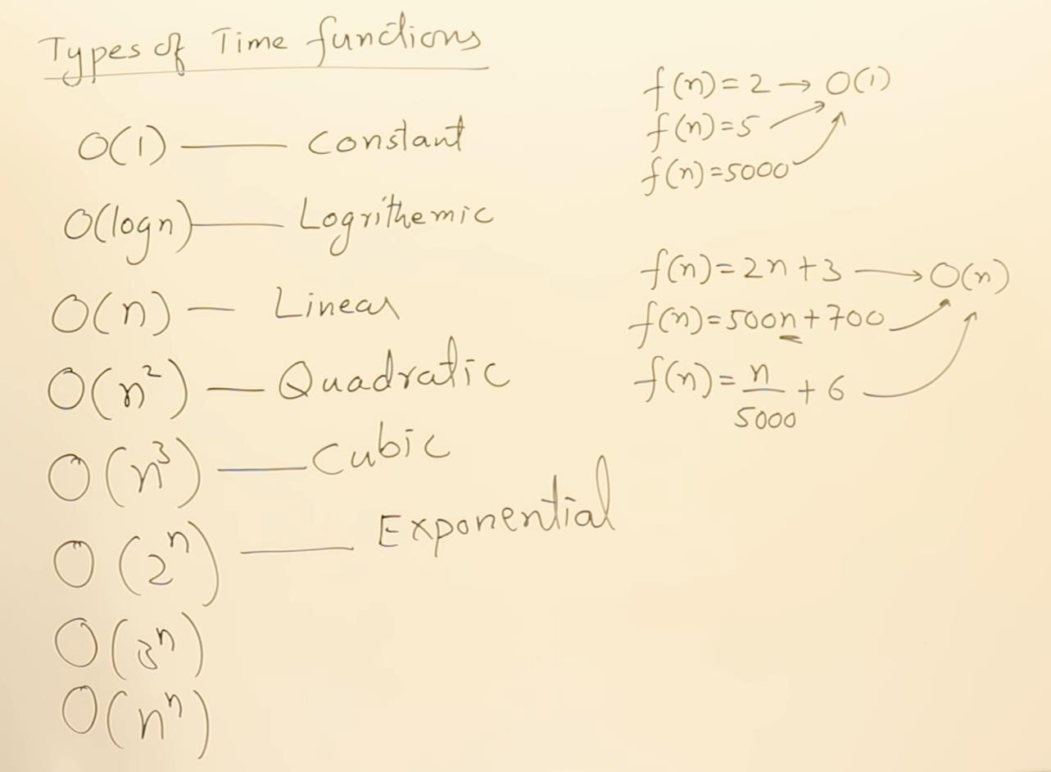


Slide 34
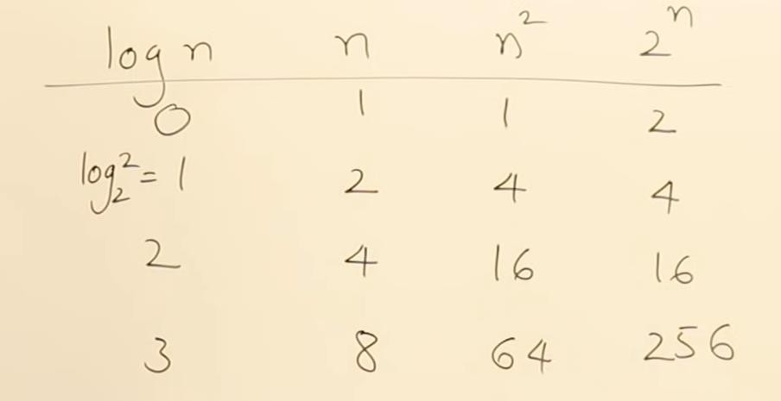
Compare Class of Functions

Slide 35
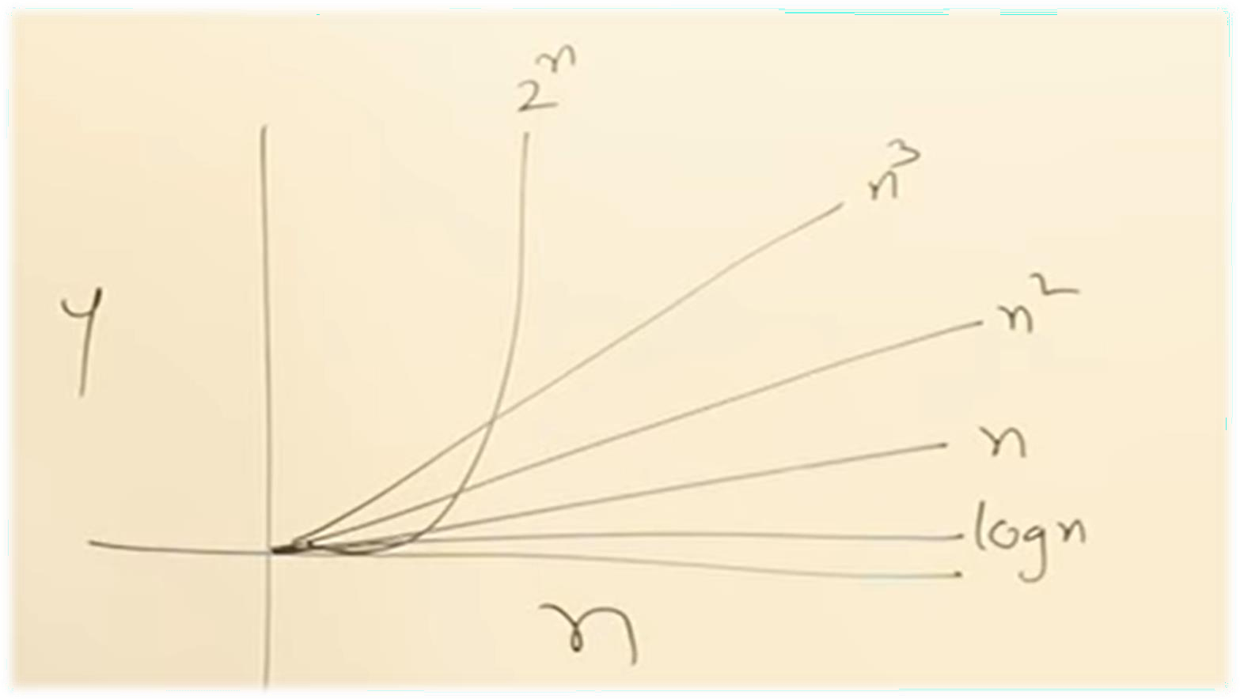
Compare Class of Functions

Slide 36
- COMPLEXITIES
O(1) – Constant Time Constant time means the running time is constant, it’s not affected by the input size. (Loop Running constant amount of times)
O(log n) – Logarithmic Time Algorithm that has running time O(log n) is slight faster than O(n). Commonly, algorithm divides the problem into sub problems with the same size. Example: binary search algorithm, binary conversion algorithm
O(n) – Linear Time When an algorithm accepts n input size, it would perform n operations.
O(n log n) – Linearithmic Time This running time is often found in "divide & conquer algorithms" which divide the problem into sub problems recursively and then merge them in n time. Example: Merge Sort algorithm.
O(n²) – Quadratic Time Look Bubble Sort algorithm!
O(n³) – Cubic Time It has the same principle with O(n²).
O(2^{n}) – Exponential Time It is very slow as input get larger, if n = 1000.000, T(n) would be 2^1000.000. Brute Force algorithm has this running time.
O(n!) – Factorial Time THE SLOWEST => Example : Travel Salesman Problem (TSP)

